Slide 1


Eco-systems mapping

Slide 2

The three pillars of corporate innovation strategy
What technology should be prioritized?
WHAT ?
Innovation Strategy
Where to locate innovation activities?
Who to connect with?
WHERE?
WHO ?
4
5

Slide 3
From strategic challenges to data solutions
WHAT?
WHERE?
WHO?
Strategic
challenge
What technology should be prioritized?
Where to locate innovation activities?
Who to connect with?
Level of
analysis
Technological ecosystems
Urban ecosystems
Actor ecosystems
Actor ecosystems
Key
metrics
Classification Velocity Relatedness
Patent counts Relatedness density Comp. Advantages
Patent counts Patent shares
Patent counts
Patent shares
Business
decisions
R&D investments
Tech diversification
New use cases
Spatial scouting
Set-up incubators
Locate R&D labs
Collaborations
M&As
Talent acquisitions
5

Slide 4
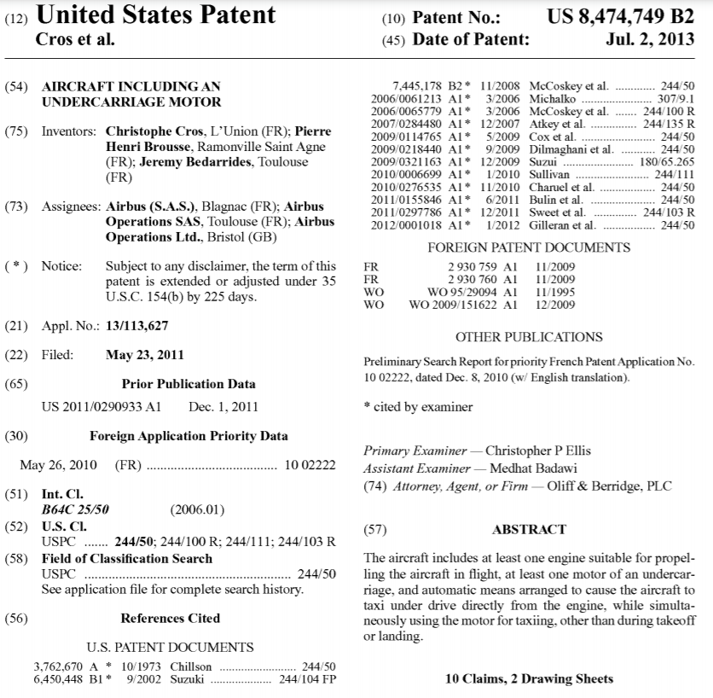
Analysis of large patent datasets
Publication date
Precise geolocation of the place of knowledge production based on inventors home adresses
Citations to other patents
Application date
Citation to non-patent literature (scientific publications, reports)
Specific classification in one of the 250,000 different technological category
Summary +
complete text
9
5

Slide 5

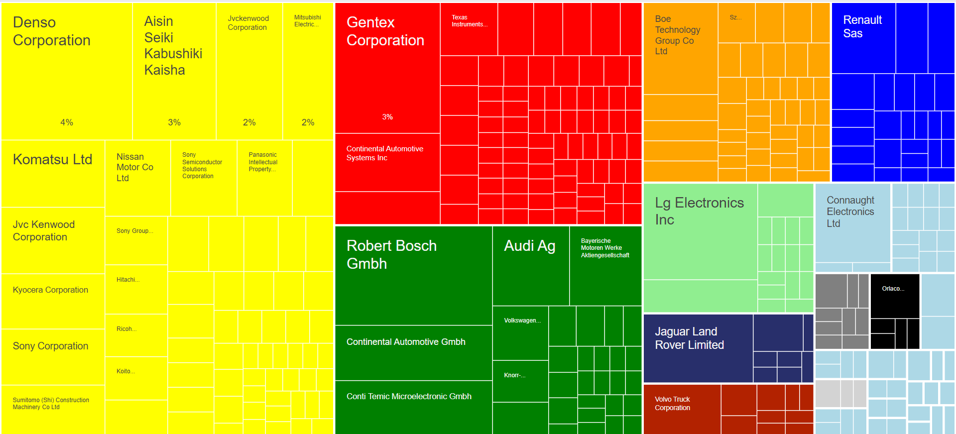
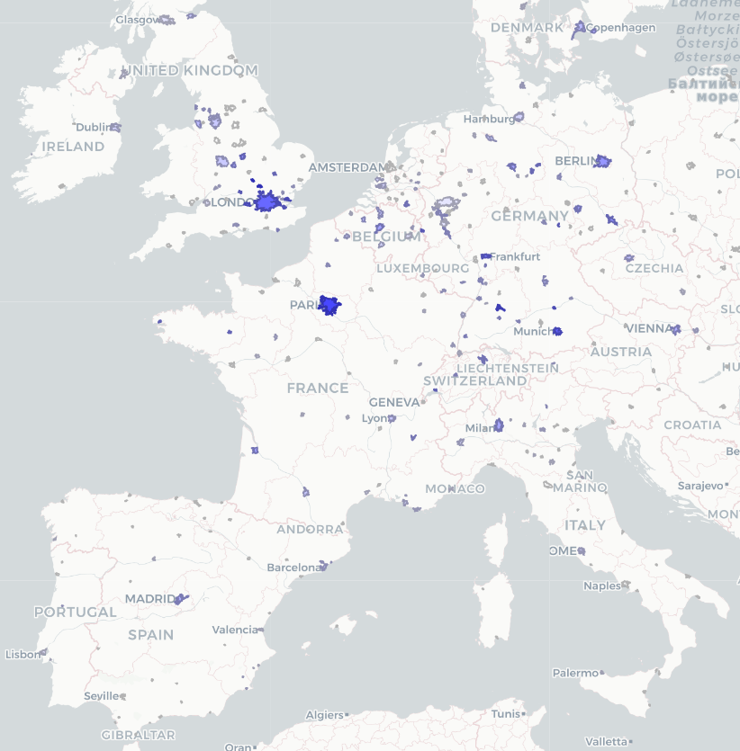
High-end interactive data visualizations tools
Key information for strategy decision making are made available through high-end interactive data visualizations tools (HTML). Links to the interactive material are launched by
Share of patents produced by a given company/inventor – top candidates for strategic collaborations & hiring
Urban ecosystems with the highest relatedness density, relative comparative advantage and patent counts – top candidates for location choices
10
5

Slide 6
Technological landscape

Slide 7
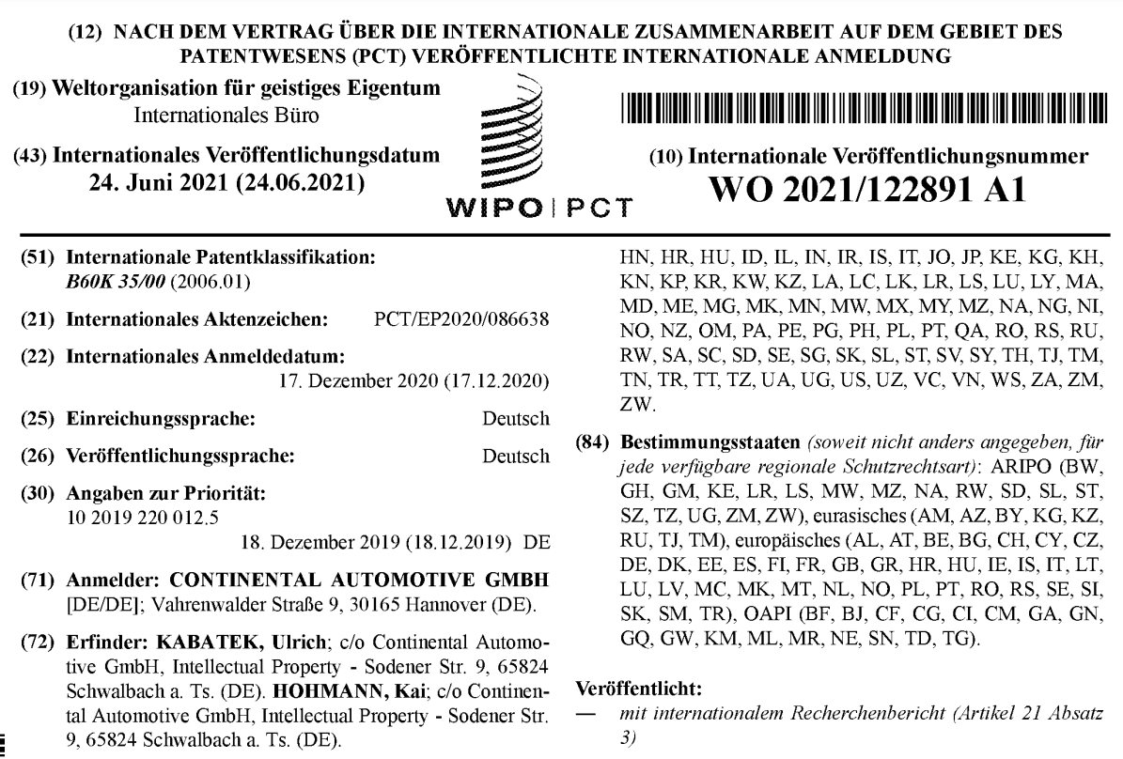

Classification of patents in strategic domains
We use a text mining algorithm to identify the patents that corresponds to the 8 strategic domains of head-up displays, computer-aided design, optical systems (general), holography, screen displays (vehicules), optical components, arrangement for software engineering & Automotive ECUs.
First, domain experts & Argos delineate the technological landscape and set up a list of key words that characterize the different strategic domains.
Second, a text mining algorithm searches these key words and their specific association in the text of patent documents as well as in the Cooperative Patent Classification (CPC) nomenclature. The CPC nomenclature is developed and maintained by the European Patent Office (EPO) and the US Patent and Trademark Office.
The algorithm returns a list the specific technological classes are most frequently associated with these key words. For ‘Screen displays (vehicules)’ for instance, the algorithm returns the class B60K2370/152.
In a third step, all the CPC classes associated by the algorithm with the 8 strategic domains are manually checked by Continental experts & Argos.
12
5

Slide 8
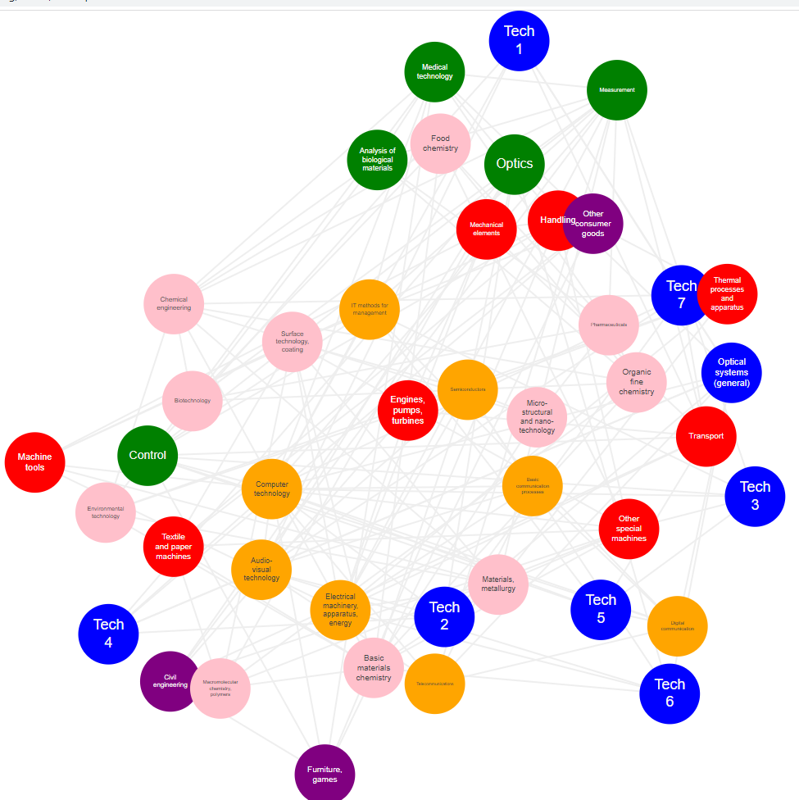
Technology space and relatedness measure
The technology space is a representation of the technological links between the different strategic domains (relatedness).
Elements of the TS represent different (sub-) strategic domains and links between them represents their degree of relatedness. The degree of relatedness is measured in 2 steps:
- Count of co-occurrences of 2 domains in the same patent
- Normalization of theses cooccurrences using the cosine index
The exploration of the technology space allows to understand the links between technologies and the way knowledge recombines into new inventions.
Relatedness metrics are the building blocks of recommendation systems predicting new location hubs or company’s diversification potential in different domains.
13
5

Slide 9
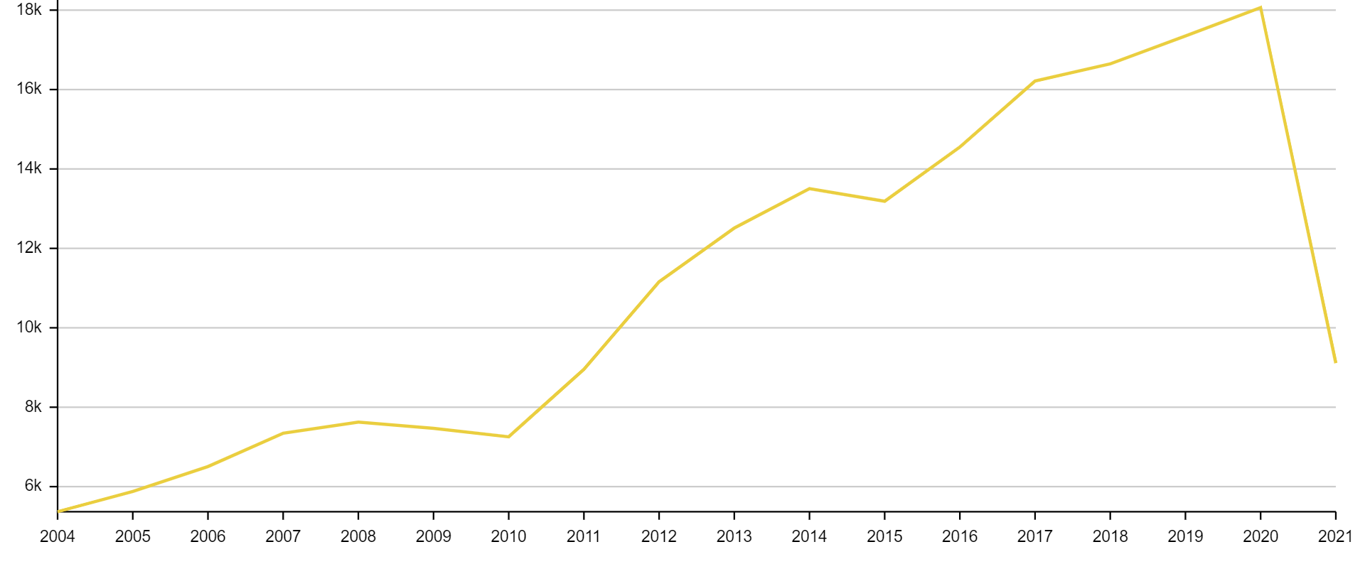
Velocity – Optical systems
+236%
15
5

Slide 10
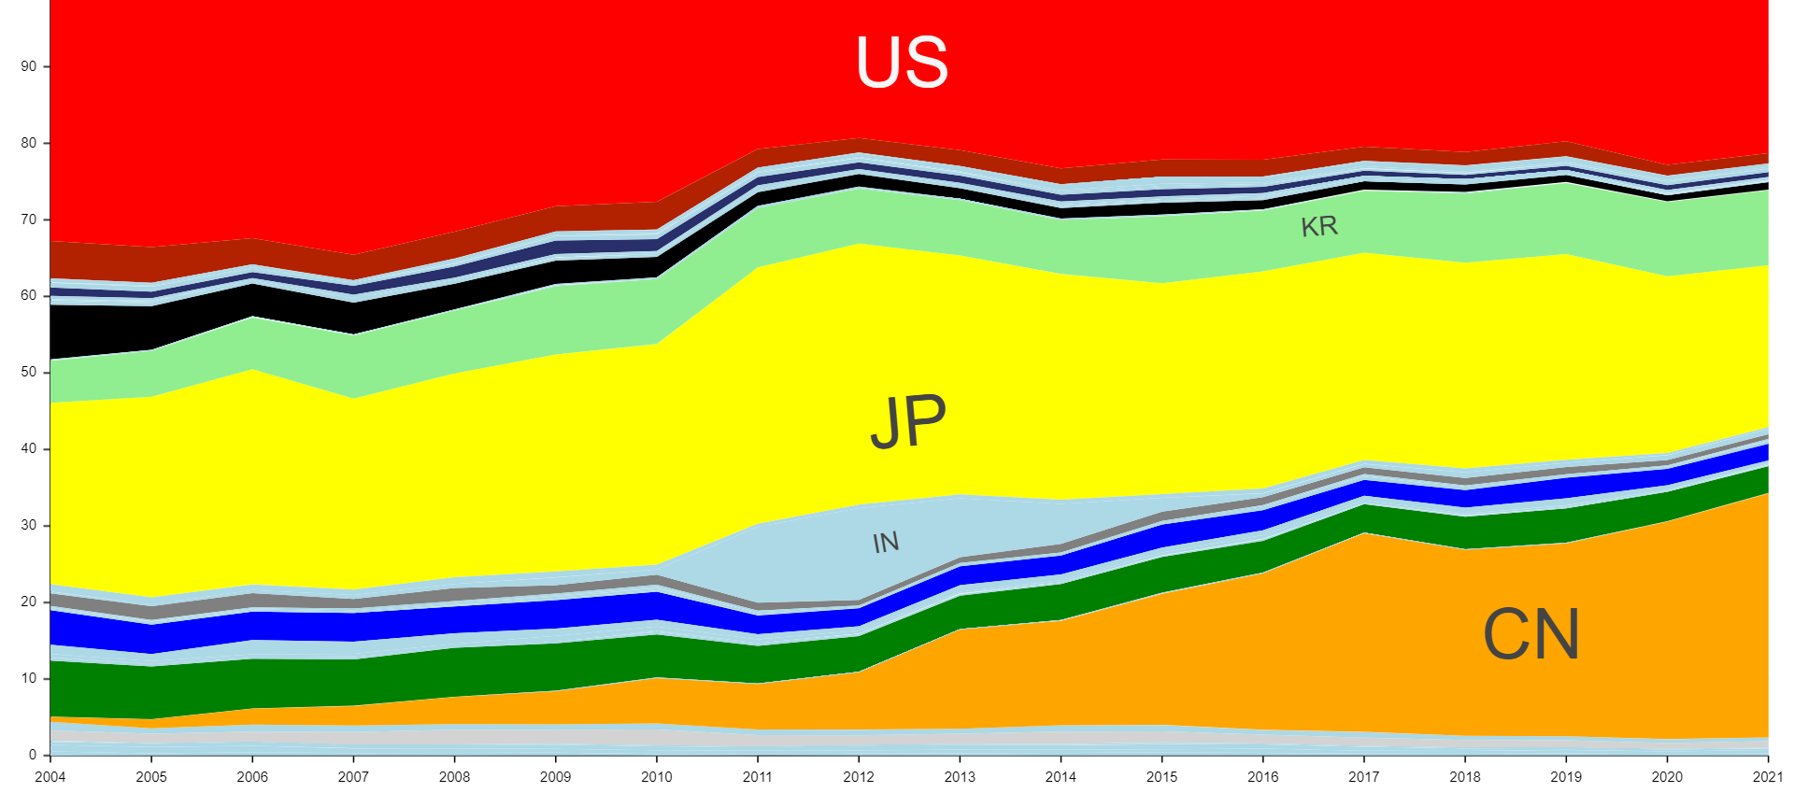
Velocity per country – Optical systems
23
5

Slide 11
World urban ecosystems

Slide 12
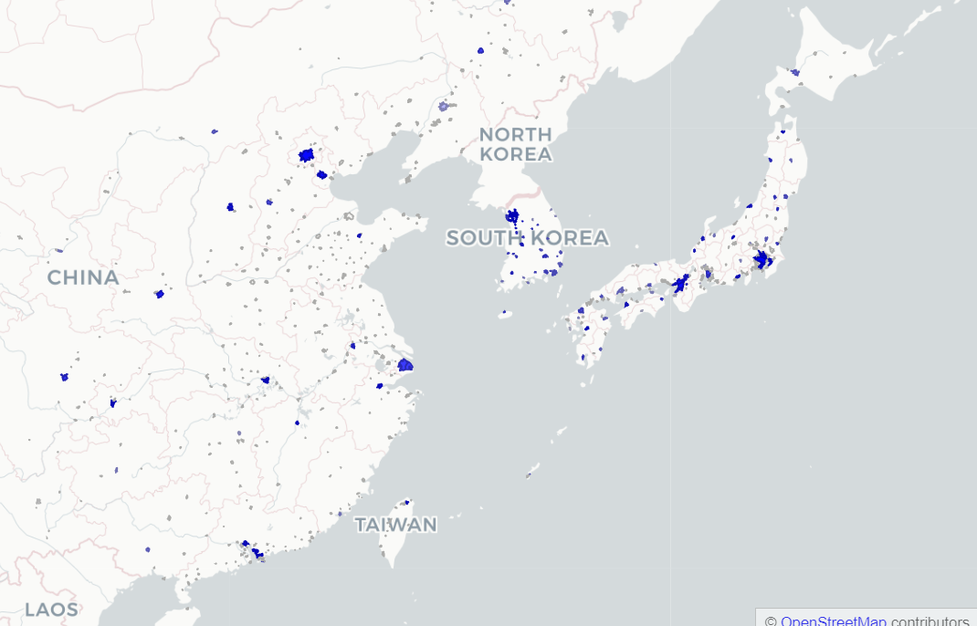
East Asia – Optical systems
Beijing (#2)
Seoul (#2)
Tokyo (#1)
Hangzhou (#7)
Shenzhen (#4)
34

Slide 13
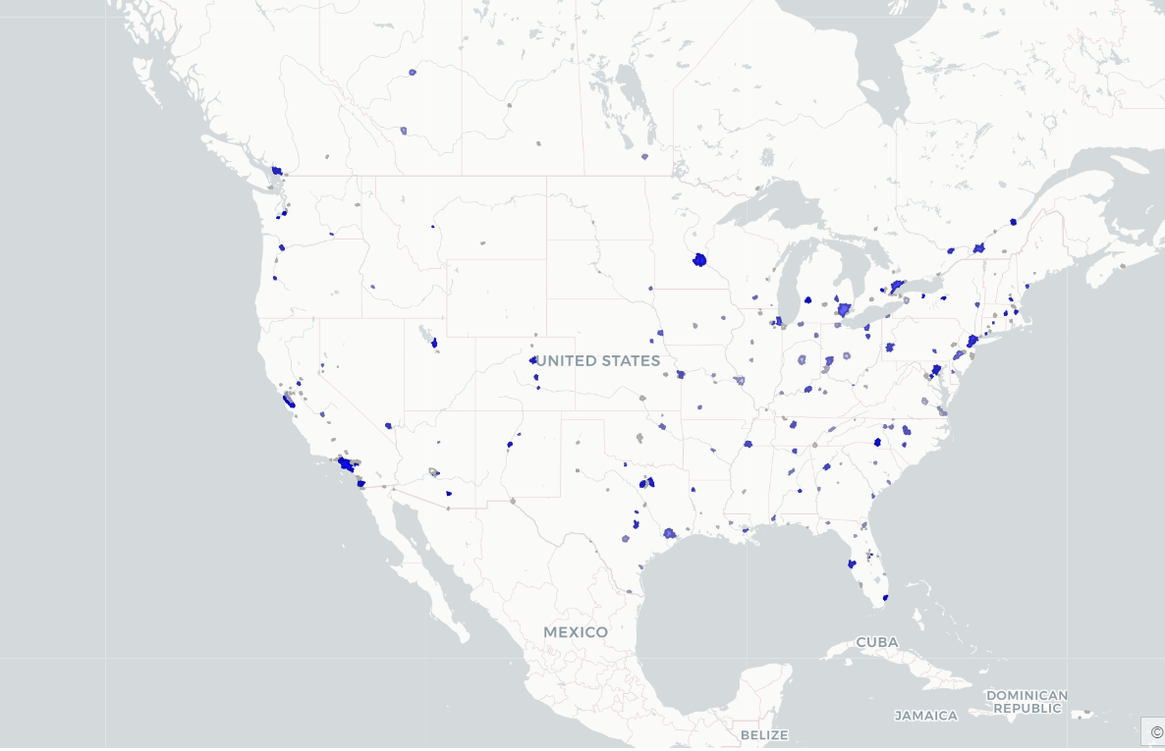
North America – Optical systems
Seattle (#11)
San José - SF (#5)
Rochester NY (#13)
Los Angeles (#6)
Miami (#18)
35

Slide 14
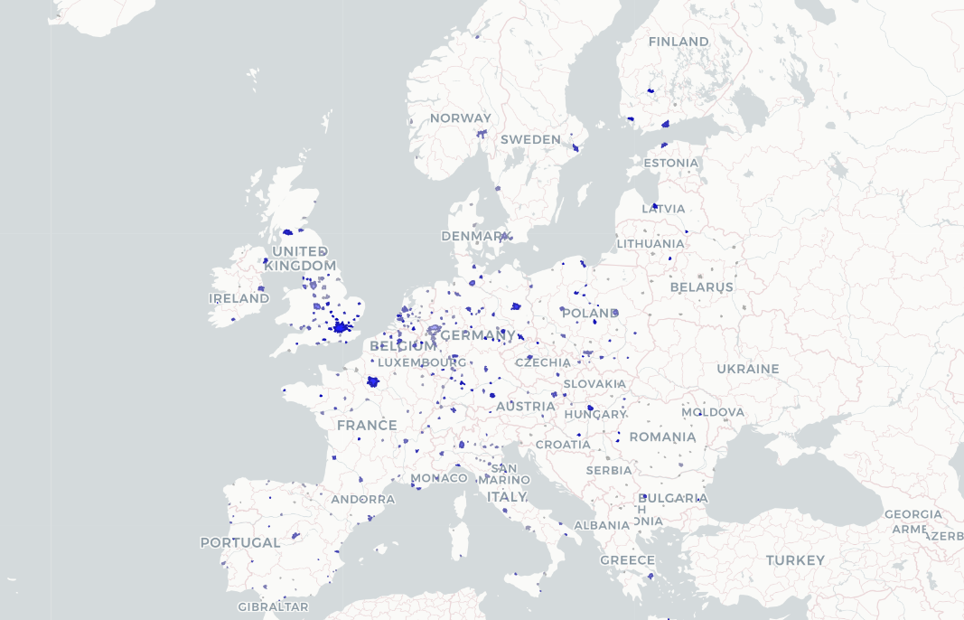
Europe – Optical systems
Tempere (#15)
Eindhoven (#31)
Aachen (#28)
Jena (#17)
Rennes (#10)
Tel Aviv (#22)
36

Slide 15
Key organizations & inventors

Slide 16
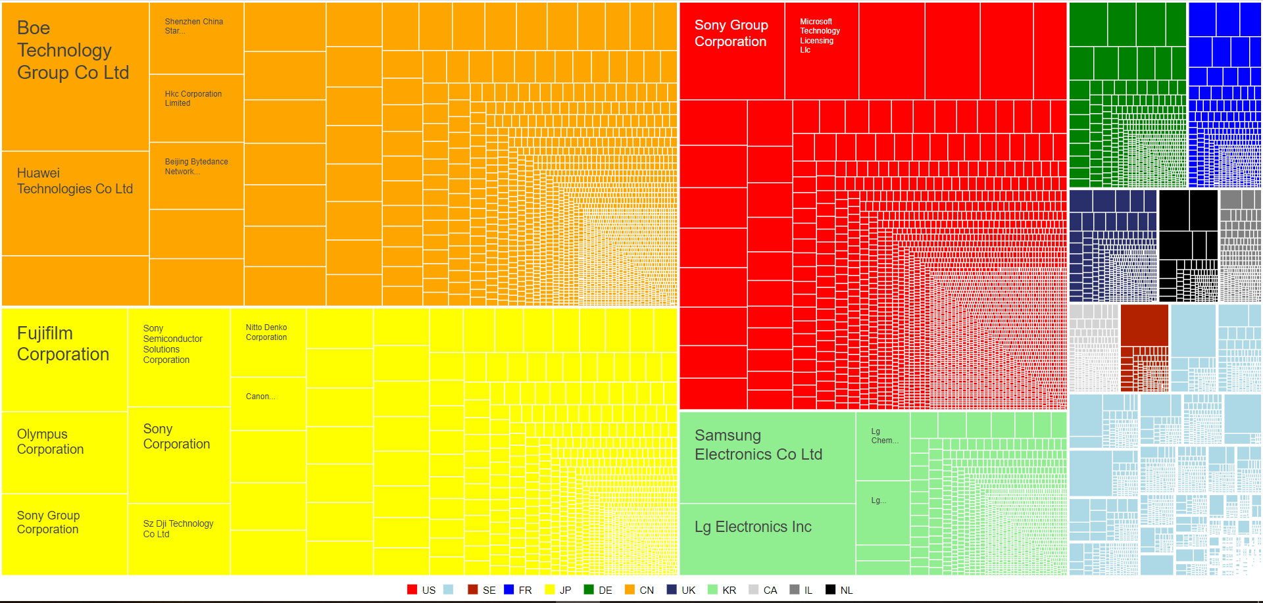
Key actors (applicants) – Optical systems
57
5

Slide 17
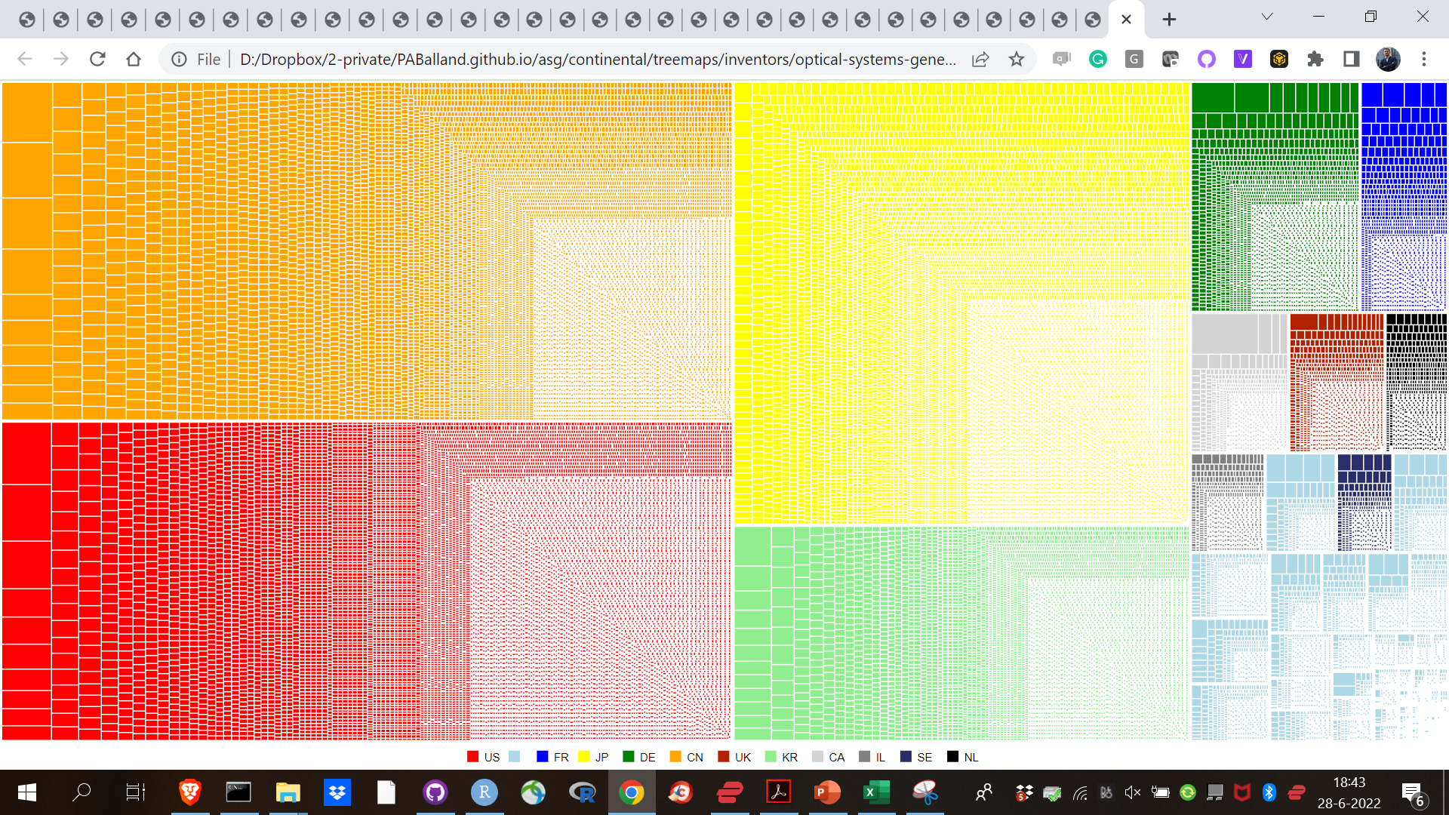
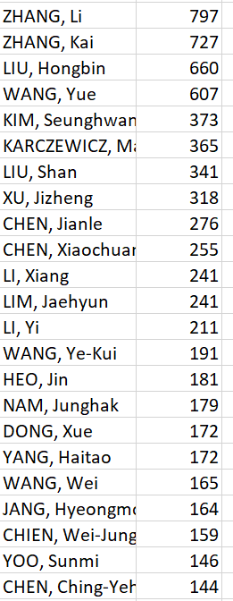
Key actors (inventors) – Optical systems
65
5

Slide 18
Key organizations & inventors in urban ecosystems

Slide 19
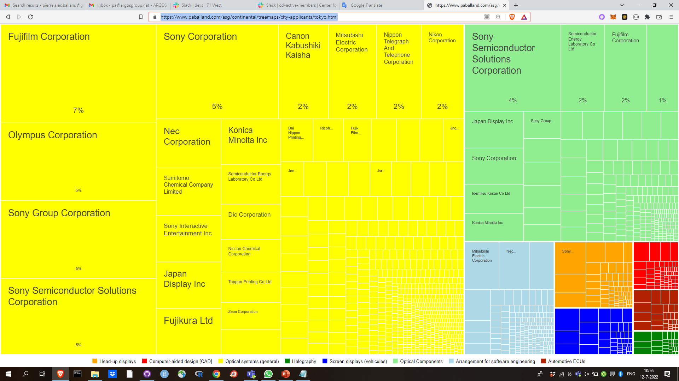
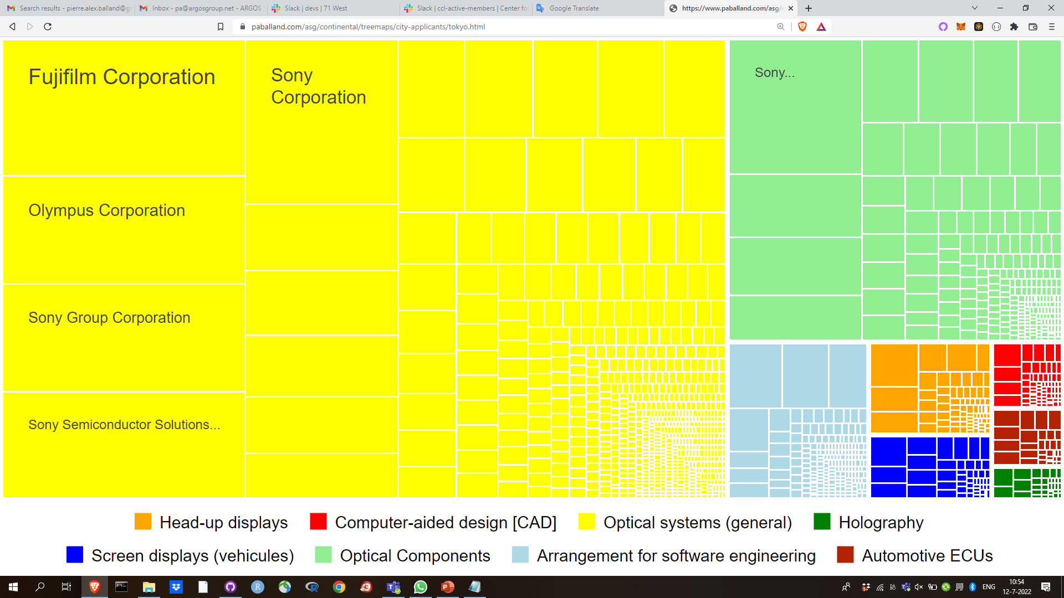
Applicants – Tokyo
71
5

Slide 20
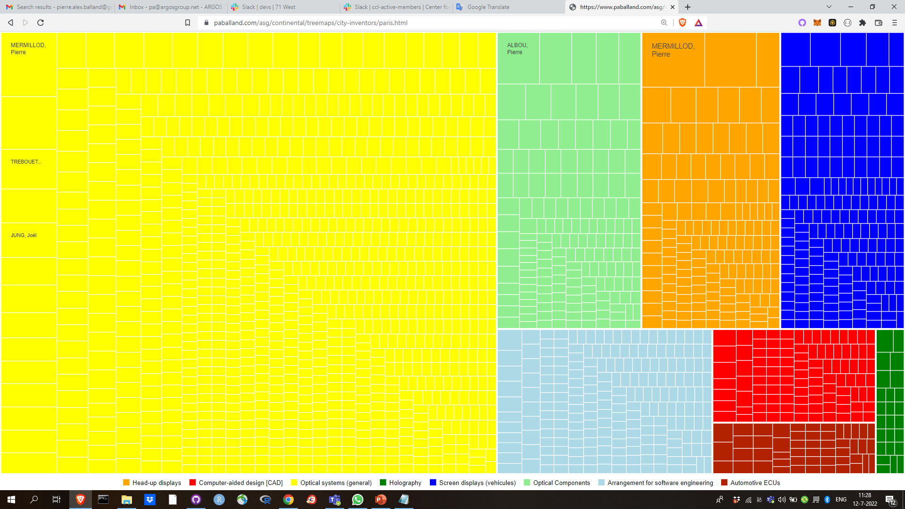
Inventors – Paris
71
5

